Slide 1

A Tuwaiq Data Science Bootcamp Project
Guessing Income Project
Notes:
This slide contains the editable pieces that were used to build infographic sample
Icons – Eye, PC

Slide 2
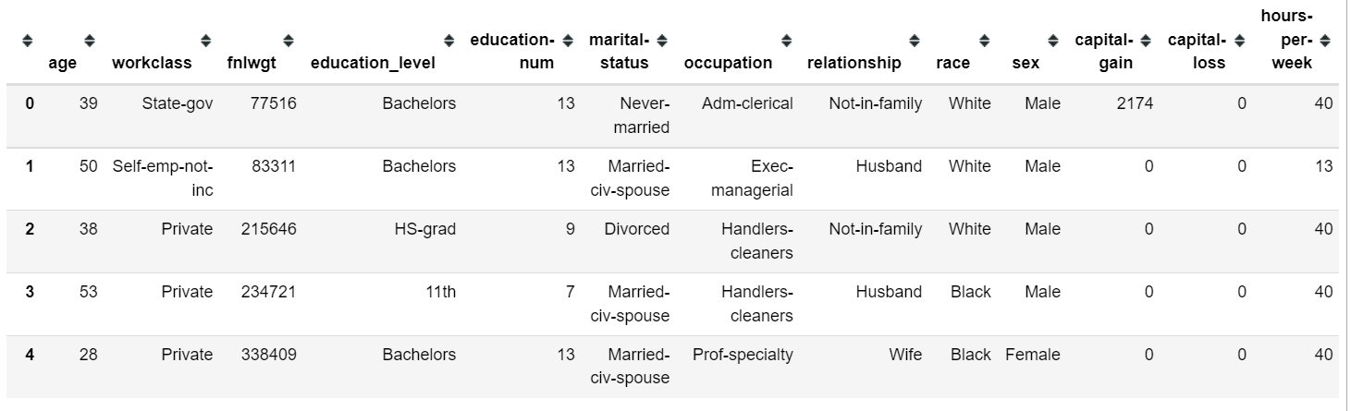
Introduction
The dataset
According to the sources, this data was extracted by Barry Becker from 1994 Census database. It was meant to predict whether a person makes over 50K a year or less.
It consists of 32561 rows and 15 columns
The source of the dataset
The data can be found in UCI Machine Learning Repository

Slide 3
Exploring the Dataset
Exploring dataset summary
The dataset consists of 15 columns and 32561 rows. We have 32561 non_null records in all of the 15 columns in the dataset. The data types are str and int data types. From the description of the dataset, I found the following: The ages are between 90 and 17 years old. The Capital gain is between 0 and 99999. The Capital loss is between 0 and 4356. The Working hours per week are between 1 hour to 99 hours. By checking the duplicated records, I found that there are no duplication as the rows overall are unique. The income information is classified as it follows: >50K yearlly income. <=50K yearlly income.

Slide 4
Cleaning the Dataset
Cleaning Findings
Overall: Finding 1: The columns have (-) to separate between words. Action: The columns will be renamed with (_) as a separator between words. Values issues Findings: Finding 1: The following columns has 4262 records as "?" value: workclass occupation native-country Action: Remove the records as we don't have the missing information to fill them. Finding 2: An extra space at the beginning of each string value in the dataset. Action: Remove the extra space. Finding 3: Column "fnlwgt" has no meaning that may help in this project. Action: Drop this column.

Slide 5
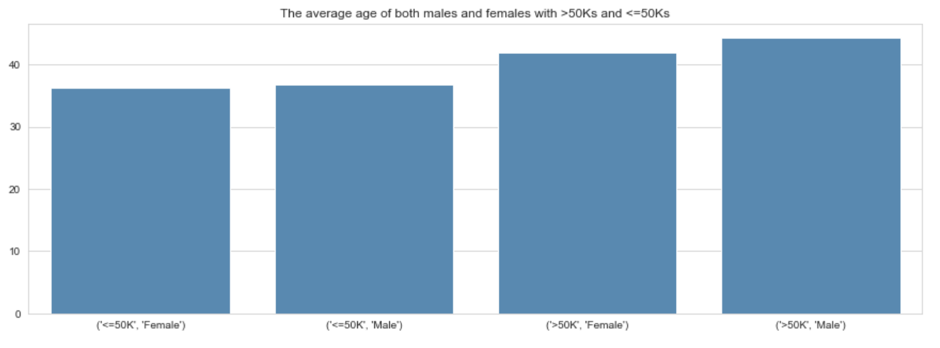
Visualization
The question:
T1- What is the age average for each gender of the individuals with the income over 50K and at most 50K?
The answer:
1. The age average of the females and males, who are making 50Ks or less is between 30 and 40 years old. 2. The age average of the females and males, who are making over 50Ks is over 40 years old.
5

Slide 6
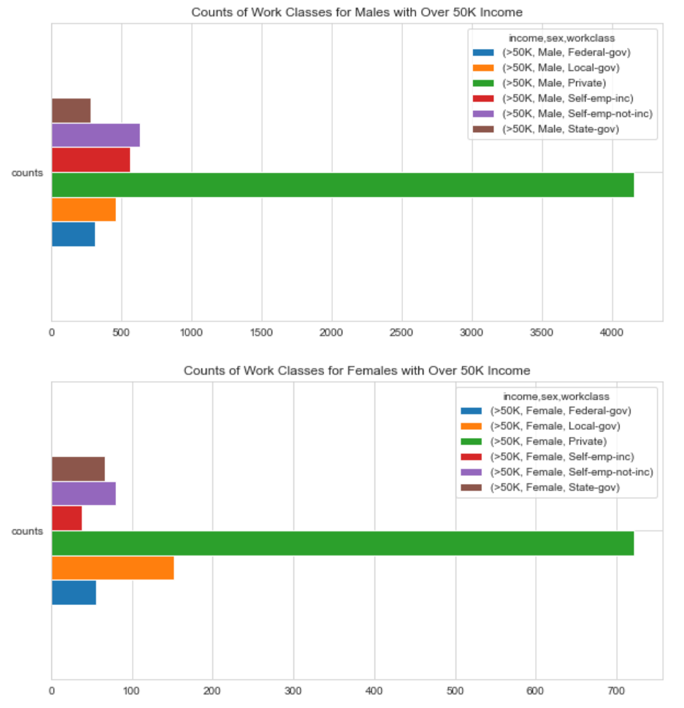
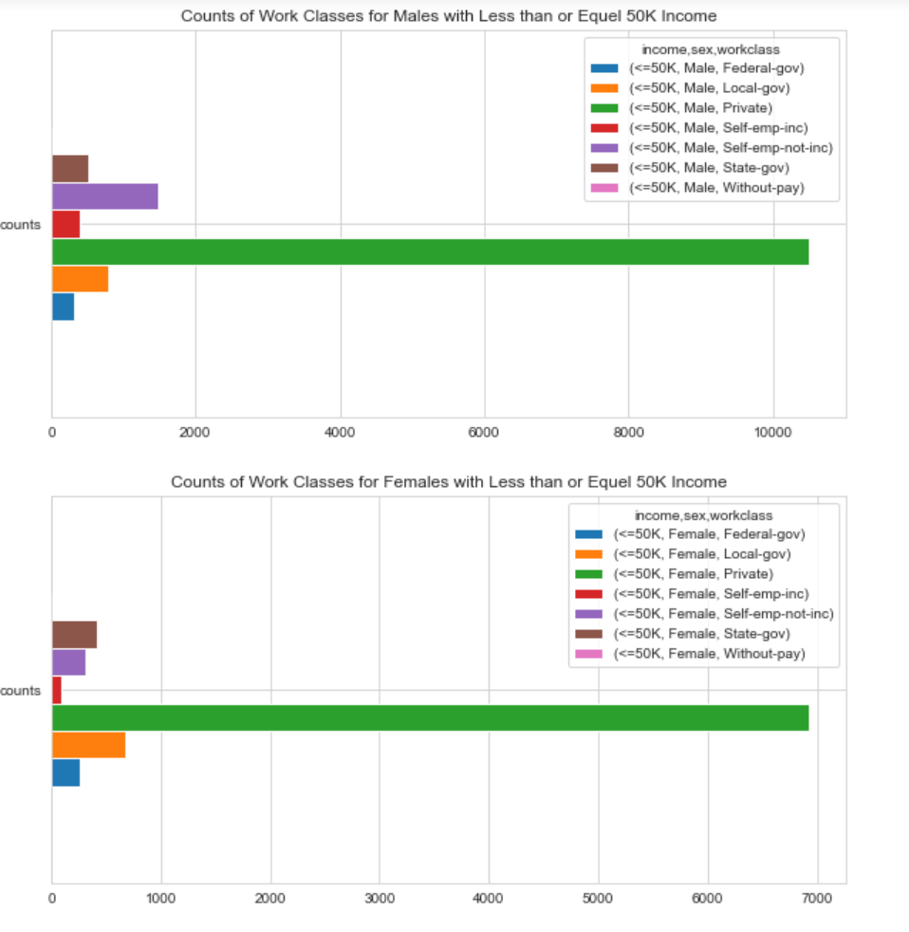
Visualization
The question:
2- In which work class both genders, who make over 50K or 50K or less a year, are mostly working in?
The answer:
From the plot, we can find that the majority of the individuals in the dataset are working in the private sector whether they make 50Ks or less or over 50Ks a year. This information can't lead us to know the real effect of the work class on the income.
6

Slide 7
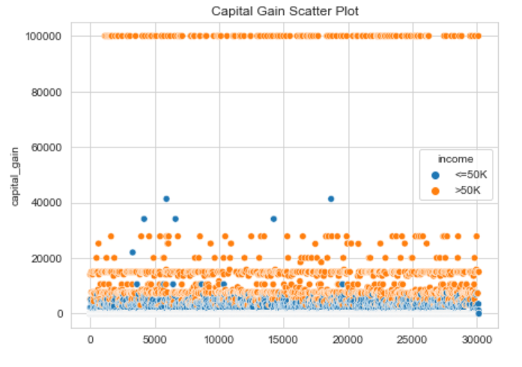
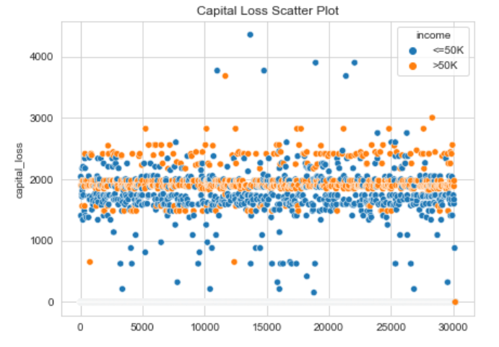
Visualization
The question:
3- Are the individuals with more than 50Ks a year have a capital gain more than a capital loss?
The answer:
Here we can find that the increase of the Capital Gain and the Capital Loss is happening when the income is greater than 50K. It indicates that the individuals with an income greater than 50Ks a year are active financially and gaining more than losing.
7

Slide 8
Modeling
Preparing for the modeling
As a preparation, I have wen through the following: Encoding the income values to be 0 and 1: 0 for <=50K 1 for >50K Log transformation for 'capital_gain', 'capital_loss’ as they are both are skewed. Oversampling the dataset using resample function. Encoding the non-numeric data using get_dummies function.

Slide 9
Modeling
Building the model
There are many classification models available. To choose the best, I tested 6 different models: 1- logistic regression 2- Ada Boost Classifier 3- Gaussian NB 4- Decision Tree Classifier 5- Random Forest Classifier 6- Gradient Boosting Classifier To compare them, I used the following values: 1- f1-score. 2- accuracy. 3- MSE. 4- The confusion Matrix.

Slide 10
Modeling
The results
Model | F1-score (0 and 1) | Accuracy | MSE
logistic regression | 0.81 | 0.81 | 0.183
 | 0.82
Ada Boost Classifier | 0.82 | 0.83 | 0.170
 | 0.83
Gaussian NB | 0.65 | 0.72 | 0.276
 | 0.77
Decision Tree Classifier | 0.89 | 0.90 | 0.128
 | 0.90
Random Forest Classifier | 0.90 | 0.91 | 0.112
 | 0.91
Gradient Boosting Classifier | 0.83 | 0.84 | 0.161
 | 0.84

Slide 11
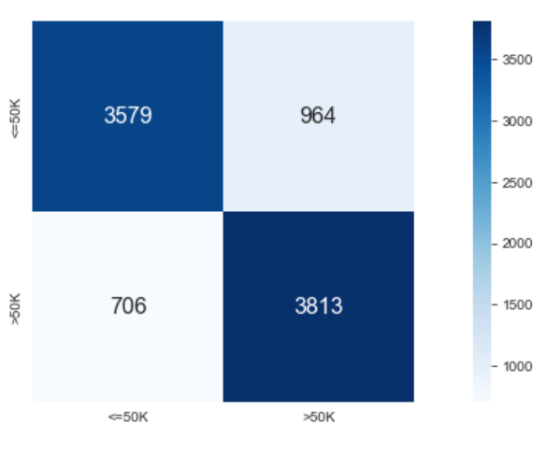
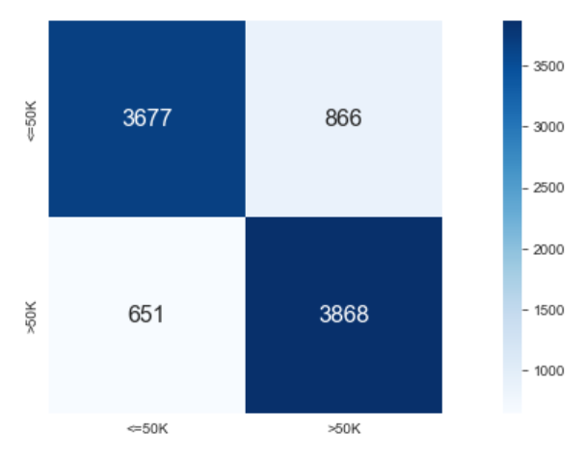
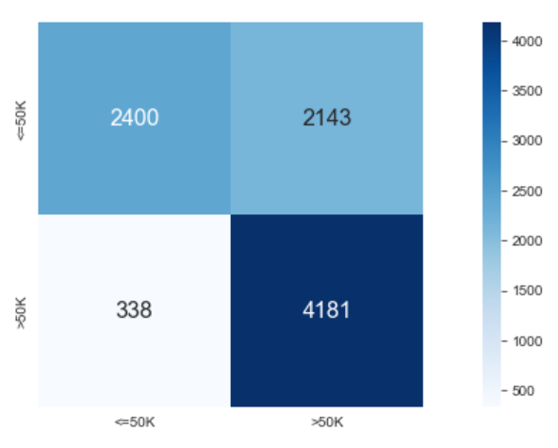
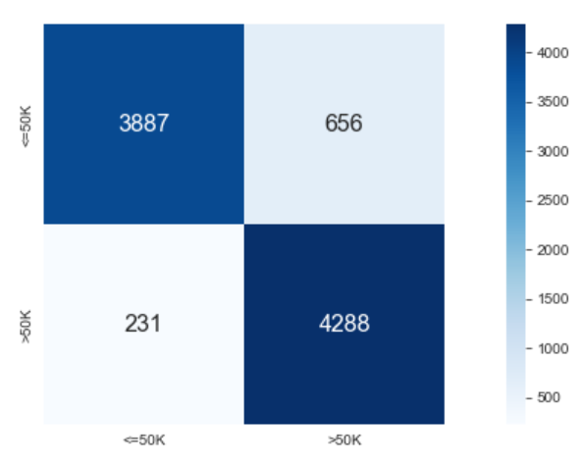
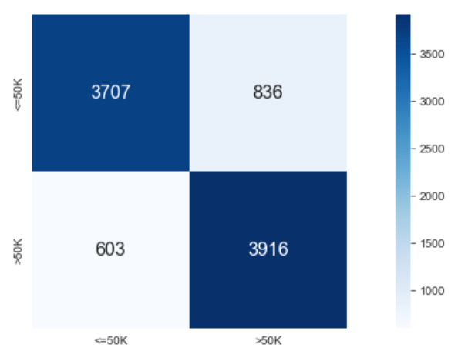
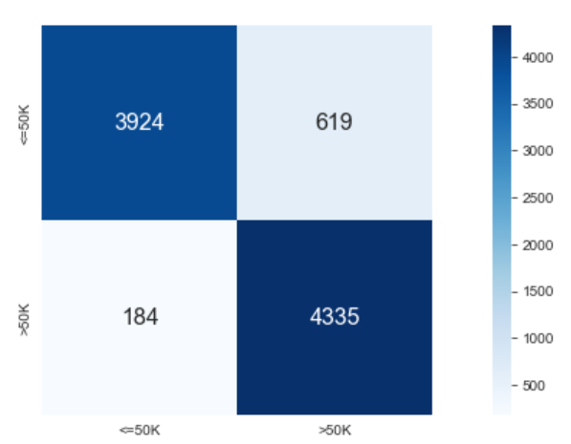
Modeling
The results
logistic regression
Ada Boost Classifier
Gaussian NB
Decision Tree Classifier
Gradient Boosting Classifier
Random Forest Classifier

Slide 12
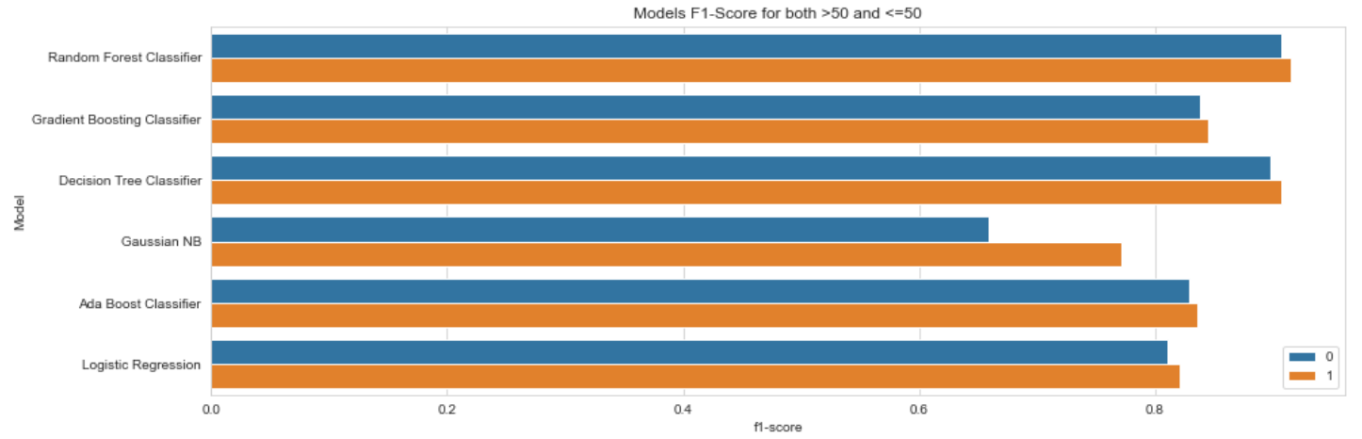
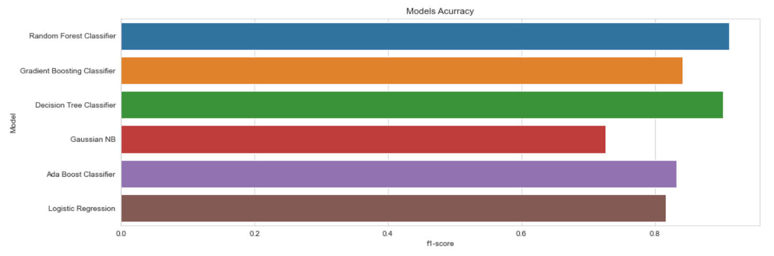
Conclusion
The best model
From the results, I can say that the Random Forest Classifier model is the best model: 1. It has the lowest MSE. 2. It has the highest f1-score. 3. It has the best confusion matrix. 4. It has the highest accuracy score.

Slide 13
Ending slide
The end of the Presentation
Notes:
This slide contains the editable pieces that were used to build infographic sample
Icons – Eye, PC

